Slide 1

P peline
The Data
Introductory Statistics: T-Test, Correlation & Regression
© Jennifer Mankoff
The Data Pipeline; HCII; Spring 2014

Slide 2
Goals
After this, you should be able to:
Calculate and interpret the a t-statistic
Check that your data meets the assumptions of a t-test
Critique incorrect use of t-test
http://fivethirtyeight.com/features/science-isnt-broken/#part2

Slide 3
Common Statistical Tests: T-test
Outcome Variable | Are the observations independent or correlated? |  | Alternatives if the normality assumption is violated (and small sample size):
 | independent | correlated
Continuous (e.g. pain scale, cognitive function) | T-test: compares means between two independent groups ANOVA: compares means between more than two independent groups Pearson’s correlation coefficient (linear correlation): shows linear correlation between two continuous variables Linear regression: multivariate regression technique used when the outcome is continuous; gives slopes | Paired t-test: compares means between two related groups (e.g., the same subjects before and after) Repeated-measures ANOVA: compares changes over time in the means of two or more groups (repeated measurements) Mixed models/GEE modeling: multivariate regression techniques to compare changes over time between two or more groups; gives rate of change over time | Non-parametric statistics Wilcoxon sign-rank test: non-parametric alternative to the paired ttest Wilcoxon sum-rank test (=Mann-Whitney U test): non-parametric alternative to the ttest Kruskal-Wallis test: non-parametric alternative to ANOVA Spearman rank correlation coefficient: non-parametric alternative to Pearson’s correlation coefficient
Adapted from: www.stanford.edu/~kcobb/hrp259/lecture13.ppt

Slide 4
Testing a Hypothesis
Example: Random sample of 50 students
Mean height of sample: 66
Question: Could the true mean be 68 (given this sample)?
Answer: Calculated using a significance test

Slide 5
Central limit theorem (again)
Draw many random independent samples
The sample means form a normal distribution
(even if the original population is skewed!)
Normally we have only one sample though

Slide 6
Z-score quantifies how good your sample is
(X bar) sample mean
μ (mu) population mean
(sigma_pop) population std. dev

Slide 7
Z-score quantifies how good your sample is
sample mean
μ population mean
population std. dev
Z-score “standard score”

Slide 8
Z-score quantifies how good your sample is
Z-score “standard score”
Provides a measure of
how well a sample mean approximates the population mean
how much difference between and μ is reasonable to expect just by chance
Requires knowledge of population (μ & )
Inference & Bayesian Reasoning Aagain…

Slide 9
t statistic
t statistic is an ‘estimated’ z score.
Replace μ with a guess about the true mean (compare to a guess)
Compare two populations to see if their means differ
Estimation says whether the difference is ‘due to chance’ (H₀, also called the null hypothesis) or ‘real’
Works best with large sample sizes
Thus, degrees of freedom (df = N-1) is used to describe how well t represents z
‘Amount’ of chance is explicit (e.g. 95% confidence)
Notes:
T is a what if scenario (what if two things are the same). If the difference between them is large, this is unlikely. Otherwise the reverse is true.

Slide 10
Six Steps for Significance Tests
A one-sample t-test
tests whether a number (such as 68) is the same as the sample mean (such as 66 in our example) [null hypothesis]

Slide 11
Six Steps for Significance Tests
1 Set α (alpha or p level)

Slide 12
Six Steps for Significance Tests
1 Set α (alpha or p level) (typically .05 or .01)
2.5%
95%
2.5%
Notes:
If our observed age value lies outside the green lines, the probability of getting a value as extreme as this if the null hypothesis is true is < 5%
Small p values narrow the green lines

Slide 13
Six Steps for Significance Tests
1 Set α (alpha or p level) (.05)

Slide 14
Six Steps for Significance Tests
1 Set α (alpha or p level) (.05)
2 State null and alternative hypotheses
Is the discrepancy simply due to chance?
Sample mean approximates the population mean
Is the discrepancy more than would be expected by chance?
Sample mean is different the population mean
Population mean = 66
Population mean ≠ 66

Slide 15
Six Steps for Significance Tests
1 Set α (alpha or p level) (.05)
2 State null and alternative hypotheses
Is the discrepancy simply due to chance?
Sample mean approximates the population mean
Is the discrepancy more than would be expected by chance?
Sample mean is different the population mean
Population mean = 66
Population mean ≠ 66
This is the unknown (but hypothesized) population mean

Slide 16
Six Steps for Significance Tests
1 Set α (alpha or p level) (.05)
2 State null and alternative hypotheses
Is the discrepancy simply due to chance?
Sample mean approximates the population mean
Is the discrepancy more than would be expected by chance?
Sample mean is different the population mean
Population mean = 66
Population mean ≠ 66

Slide 17
Six Steps for Significance Tests
1 Set α (alpha or p level) (.05)
2 State null and alternative hypotheses
3 Calculate test statistic (t)

Slide 18
Six Steps for Significance Tests
1 Set α (alpha or p level) (.05)
2 State null and alternative hypotheses
3 Calculate test statistic (t)
Standard error: Std Dv and N are derived from the sample

Slide 19
Six Steps for Significance Tests
1 Set α (alpha or p level) (.05)
2 State null and alternative hypotheses
3 Calculate test statistic (t)
remember:
t approximates

Slide 20
Six Steps for Significance Tests
1 Set α (alpha or p level) (.05)
2 State null and alternative hypotheses
3 Calculate test statistic (t)

Slide 21
Six Steps for Significance Tests
1 Set α (alpha or p level) (.05)
2 State null and alternative hypotheses
3 Calculate test statistic (t) (-2.5)

Slide 22
Six Steps for Significance Tests
1 Set α (alpha or p level) (.05)
2 State null and alternative hypotheses
3 Calculate test statistic (t) (-2.5)
4 Determine the critical value (look up α and N-1)

Slide 23
Six Steps for Significance Tests
1 Set α (alpha or p level) (.05)
2 State null and alternative hypotheses
3 Calculate test statistic (t) (-2.5)
4 Determine the critical value (look up α and N-1). α=.05; N-1 = 24. t_{.05} = 2.06

Slide 24
Six Steps for Significance Tests
1 Set α (alpha or p level) (.05)
2 State null and alternative hypotheses
3 Calculate test statistic (t) (-2.5)
4 Determine the critical value (t_{α}) (2.06)

Slide 25
Six Steps for Significance Tests
1 Set α (alpha or p level) (.05)
2 State null and alternative hypotheses
3 Calculate test statistic (t) (-2.5)
4 Determine the critical value (t_{α}) (2.06)
5 State decision rule

Slide 26
Six Steps for Significance Tests
1 Set α (alpha or p level) (.05)
2 State null and alternative hypotheses
3 Calculate test statistic (t) (-2.5)
4 Determine the critical value (t_{α}) (2.06)
5 State decision rule |t| < |t_{α}| → H₀ is true

Slide 27
Six Steps for Significance Tests
1 Set α (alpha or p level) (.05)
2 State null and alternative hypotheses
3 Calculate test statistic (t) (-2.5)
4 Determine the critical value (t_{α}) (2.06)
5 State decision rule |t| < |t_{α}| → H₀ is true
6 State conclusion

Slide 28
Six Steps for Significance Tests
1 Set α (alpha or p level) (.05)
2 State null and alternative hypotheses
3 Calculate test statistic (t) (-2.5)
4 Determine the critical value (t_{α}) (2.06)
5 State decision rule |t| < |t_{α}| → H₁ is rejected
else H₀ is rejected
6 State conclusion
2.5 > 2.06 Reject H₀
Notes:
Meaning? The sample was not drawn from a population with a population mean of 68

Slide 29
Review
What does a z score mean?

Slide 30
Review
What does a z score mean?
It tests how good your sample is (how many standard deviations from the population mean the sample mean is)

Slide 31
Review
What does a z score mean?
What does a t statistic mean?
where:

Slide 32
Review
What does a z score mean?
What does a t statistic mean?
where:
It is an estimated z score (based on an estimated pop mean)

Slide 33
Review
What does a z score mean?
What does a t statistic mean?
where:
One use of t is to compare to the critical value t_{α} (look up α and N-1 to get this)
→ Lets us accept or reject H₀ if t > t_{α}

Slide 34
Review
What does a z score mean?
What does a t statistic mean?
where:
If we solve for μ
This is just the formula for calculating the confidence interval

Slide 35
Confidence Intervals
Z-score
Confidence
Look up value Critical value of t
Depends on df (1 – N)
Notes:
We can use a confidence interval to “test” or decide whether a population mean has a given value.
Take a sample, set a confidence interval around the sample mean. Does the interval contain the hypothesized value?

Slide 36
Confidence Intervals: More Intuitive
Z-score
Confidence
Standard error of the population mean
Notes:
We can use a confidence interval to “test” or decide whether a population mean has a given value.
Take a sample, set a confidence interval around the sample mean. Does the interval contain the hypothesized value?

Slide 37
Confidence Intervals: More Intuitive
Z-score
Sample Mean
Notes:
We can use a confidence interval to “test” or decide whether a population mean has a given value.
Take a sample, set a confidence interval around the sample mean. Does the interval contain the hypothesized value?

Slide 38
Example
We can use a confidence interval to “test” or decide whether a population mean has a value.
Notes:
Critical value of t is 2.06. Sample was not drawn from population with mean of 68 inches.

Slide 39
Example
Sample:
height = 66 in
height = 4 in
N= 25 students
Question: Could population mean μ = 68 (with 95% confidence?)
Notes:
Critical value of t is 2.06. Sample was not drawn from population with mean of 68 inches.

Slide 40
Example
Sample:
height = 66 in
height = 4 in
N= 25 students
Question: Could μ = 68 (with 95% confidence?)
Answer: if it is in the 95% CI Interval:
Notes:
Critical value of t is 2.06. Sample was not drawn from population with mean of 68 inches.

Slide 41
Example
Sample:
height = 66 in
height = 4 in
N= 25 students
Question: Could μ = 68 (with 95% confidence?)
Answer: if it is in the 95% CI Interval:
α = .05 means we would be right 95 out of 100 times (95% CI)
Notes:
Critical value of t is 2.06. Sample was not drawn from population with mean of 68 inches.

Slide 42
Example
Sample:
height = 66 in
height = 4 in
N= 25 students
t_{.05}
Question: Could μ = 68 (with 95% confidence?)
Notes:
Critical value of t is 2.06. Sample was not drawn from population with mean of 68 inches.

Slide 43
Example
Sample:
height = 66 in
height = 4 in
N= 25 students
t_{.05}
Question: Could μ = 68 (with 95% confidence?)
This is the critical value. It comes from a table (using df = N-1 and alpha)
Notes:
Critical value of t is 2.06. Sample was not drawn from population with mean of 68 inches.

Slide 44
Example
Sample:
height = 66 in
height = 4 in
N= 25 students
t_{.05} = 2.06
Question: Could μ = 68 (with 95% confidence?)
Notes:
Critical value of t is 2.06. Sample was not drawn from population with mean of 68 inches.

Slide 45
Example
Sample:
height = 66 in
height = 4 in
N= 25 students
t_{.05} = 2.06
Standard error =
Question: Could μ = 68 (with 95% confidence?)
Notes:
Critical value of t is 2.06. Sample was not drawn from population with mean of 68 inches.
----- Meeting Notes (2/24/15 09:22) -----
samples are standard deviations
calcualte the expected standard deviation

Slide 46
Example
Sample:
height = 66 in
height = 4 in
N= 25 students
t_{.05} = 2.06
Standard error = .8
Question: Could μ = 68 (with 95% confidence?)
Notes:
Critical value of t is 2.06. Sample was not drawn from population with mean of 68 inches.

Slide 47
Example
Sample:
height = 66 in
height = 4 in
N= 25 students
t_{.05} = 2.06
Standard error = .8
Question: Could μ = 68 (with 95% confidence?)
Answer?
Notes:
Critical value of t is 2.06. Sample was not drawn from population with mean of 68 inches.

Slide 48
Example
Sample:
height = 66 in
height = 4 in
N= 25 students
t_{.05} = 2.06
Standard error = .8
Question: Could μ = 68 (with 95% confidence?)
No, 68 is not likely
Notes:
Critical value of t is 2.06. Sample was not drawn from population with mean of 68 inches.

Slide 49
Two-sample t-test
Used when we have two groups, e.g.,
Experimental vs. control group
Males vs. females
Young vs old dog
Tests whether
Notes:
Can also predict higher instead of equal

Slide 50
Two-sample t-test
Used when we have two groups, e.g.,
Experimental vs. control group
Males vs. females
Young vs old dog
Tests whether
Similar formula
Notes:
Can also predict higher instead of equal

Slide 51
Two-sample t-test
Used when we have two groups, e.g.,
Experimental vs. control group
Males vs. females
Young vs old dog
Tests whether
Similar formula
Notes:
Can also predict higher instead of equal

Slide 52
Two-sample t-test
Used when we have two groups, e.g.,
Experimental vs. control group
Males vs. females
Young vs old dog
Tests whether
Similar formula
Notes:
Can also predict higher instead of equal

Slide 53
# Months in Kennel Scores
Dog | Age <1yr | Age >1yr
1 | 10 | 8
2 | 12 | 14
3 | 13 | 12
4 | 10 | 8
5 | 8 | 12
6 | 15 | 9
7 | 13 | 10
8 | 14 | 11
9 | 10 | 12
10 | 12 | 13
11 | 10 | 8
12 | 12 | 14
13 | 13 | 12
14 | 10 | 8
15 | 8 | 12
Notes:
Let’s say we think dogs are adopted quicker when they are younger

Slide 54
# Months
From data | Age <1yr | Age >1yr
N | 15 | 15
Mean | 11.33 | 10.87
SD | 2.09 | 2.20
SD² | 4.38 | 4.84
 | 4.38/15=.292 | .323
Term | Calculation | Result
 | 11.33-10.87 | .46
 | Sqrt(.292+.323) | .78
 | .46/.78 | .59
df | 15+15-2 | 28
t_{α}(.05, 28 df) 2 tail | 2.05 | 2.05>.59, n.s.

Slide 55
Review: Potential Errors
 | Actually is: Same as Population | Actually is: Different than Population
Decision: is Same | H₀ (null): No difference | False negative
Decision: is Different | False positive | H₁: Real difference

Slide 56
Could our Estimate Be Wrong?
 | Actually is: Same as Population | Actually is: Different than Population
Decision: is Same | H₀ (null): No difference | False negative
Decision: is Different | False positive | H₁: Real difference
Erroneously detect a difference (Type I error). Directly affected by α: at .05 we make a Type I error 5 out of 100 tries. .01 reduces this error to 1 out of 100 tries.

Slide 57
Could our Estimate Be Wrong?
 | Actually is: Same as Population | Actually is: Different than Population
Decision: is Same | H₀ (null): No difference | False negative
Decision: is Different | False positive | H₁: Real difference
Fail to detect a true difference (Type II error) Indirectly affected by α: Depends on the size of the mean difference and the sample size.

Slide 58
False positive and negative Error Tradeoffs
Suppose there is a test for a particular disease (H₀ is that the person is disease free)
If the person is sick and is diagnosed early, she can be successfully treated
If it is not diagnosed and treated, the person will become severely disabled
If a person is erroneously diagnosed as having the disease and treated, no physical damage is done.
To which type of error you are willing to risk ?

Slide 59
Could our Estimate Be Wrong?
 | No Disease | Disease
Not Diagnosed | OK | False negative
Diagnosed | False positive | Ok

Slide 60
Could our Estimate Be Wrong?
 | No Disease | Disease
Not Diagnosed | OK | False negative
Diagnosed | False positive | Ok
Not treated; irreparable damage is done
Treated, but not harmed by treatment
Decision: to reduce the chance of false negatives (Type II errors), increase α (e.g. from .01 to .05)

Slide 61
Testing of hypotheses False positives & negatives
The probability of making a Type II error (β) can be decreased by increasing the level of significance (α).
it will increase the chance of false positives (Type I errors)

Slide 62
Testing of hypotheses False positives & negatives: Example
Suppose there is a test for a particular disease (H₀ is that the person is disease free)
If the person is sick and is diagnosed early, she can be successfully treated
If it is not diagnosed and treated, the person will eventually heal, but may lose some work days
If a person is erroneously diagnosed as having the disease and treated, serious damage may be done.
To which type of error you are willing to risk ?

Slide 63
Could our Estimate Be Wrong?
 | No Disease | Disease
Not Diagnosed | OK | False negative
Diagnosed | False positive | Ok
Minor loss of work days
Treated, harmed by treatment
Decision: to reduce the chance of false positives (Type I errors), decrease α (e.g. from .05 to .01)

Slide 64
Testing of hypotheses False positives & negatives
there is only 5 chance in 100 that the result termed "significant" could occur by chance alone
α =0.05
The probability of making a Type I error can be decreased by further reducing α
it will be more difficult to find a significant result
the power of the test will be decreased
the risk of false negatives will be increased

Slide 65
What if we have more than two groups?
Multiple t-tests are needed
Inherently flawed (Probability of false positives increases)
ANOVA helps to account for this (outside of scope for today)

Slide 66
Summary
A one-sample t-test tells us whether the mean of a normally distributed population has a value specified in a null hypothesis.
A two sample t-test tells us whether the means of two normally distributed populations are equal
An ANOVA lets us compare multiple groups correctly

Slide 67
Careful with p values
Does not tell us the likelihood something is true. It only lets us reject or accept a hyp.
Gives a yes or no answer: Either the null hypothesis is rejected (the result would be unlikely [defined by α] in a world where the null hypothesis was true) or it cannot be rejected
false negatives: increase α to reduce these
false positives: reduce α to reduce these

Slide 68
Important to note
These are estimates and we can make two kinds of errors (false positives & negatives)
These statistics depend on the central limit theorem and thus its assumptions
The sample is normal
If multiple samples, they are independent & have the same variance
Can only reject hypotheses [as discussed]
Notes:
Note: Add a little more about the last point

Slide 69
Important to note
These are estimates and we can make two kinds of errors (false positives & negatives)
These statistics depend on the central limit theorem and thus its assumptions
The sample is normal
If multiple samples, they are independent & have the same variance
What if the data are not normal?

Slide 70
Important to note
These are estimates and we can make two kinds of errors (false positives & negatives)
These statistics depend on the central limit theorem and thus its assumptions
The sample is normal
If multiple samples, they are independent & have the same variance
What if the data are not normal?
Use a non-parametric test (no assumptions about the distribution of the sample; but may have other assumptions)

Slide 71
How to choose your test
 | Non-parametric |  | Parametric
 | Nominal | Ordinal | Ordinal, Interval or Ratio
One Group | Chi Square goodness of fit | Wilcoxon signed rank | One tailed t-test
Two unrelated groups | Chi square | Wilcoxon rank sum test, Mann-Whitney test | Two tailed t-test
Two related groups | McNemar’s test | Wilcoxon signed rank test | Paired t-test
K unrelated groups | Chi square | Kruskall-wallis one way ANOVA | ANOVA
K related groups |  | Friedman matched samples | ANOVA with repeated measurement

Slide 72
Correlation

Slide 73
Continuous outcome (means)
Outcome Variable | Are the observations independent or correlated? |  | Alternatives if the normality assumption is violated (and small sample size):
 | independent | correlated
Continuous (e.g. pain scale, cognitive function) | T-test: compares means between two independent groups ANOVA: compares means between more than two independent groups Pearson’s correlation coefficient (linear correlation): shows linear correlation between two continuous variables Linear regression: multivariate regression technique used when the outcome is continuous; gives slopes | Paired t-test: compares means between two related groups (e.g., the same subjects before and after) Repeated-measures ANOVA: compares changes over time in the means of two or more groups (repeated measurements) Mixed models/GEE modeling: multivariate regression techniques to compare changes over time between two or more groups; gives rate of change over time | Non-parametric statistics Wilcoxon sign-rank test: non-parametric alternative to the paired ttest Wilcoxon sum-rank test (=Mann-Whitney U test): non-parametric alternative to the ttest Kruskal-Wallis test: non-parametric alternative to ANOVA Spearman rank correlation coefficient: non-parametric alternative to Pearson’s correlation coefficient
Adapted from: www.stanford.edu/~kcobb/hrp259/lecture13.ppt

Slide 74
Goals
After this, you should be able to:
Calculate and interpret the simple correlation between two variables
Determine whether the correlation is significant
Check that your data meets the assumptions of correlation
Critique incorrect use of correlation
Adapted from http://www.fordham.edu/economics/Vinod/correl-regr.ppt

Slide 75
Scatter Plots and Correlation
A scatter plot & correlation analysis are measures of association (linear relationship) between two variables
These variables change together
Usually scale (interval or ratio) variables

Slide 76
What is “Linear”?
Remember this:
Y=mX+B?
m (slope)
B (intercept)
Adapted from: http://www.sjsu.edu/people/steven.macramalla/courses/stats95/s1/lecture 10
Notes:
A slope of 2 means that every 1-unit change in X yields a 2-unit change in Y.

Slide 77
Residual Analysis
Purposes
Examine for linearity assumption
Examine for constant variance for all levels of x
Evaluate normal distribution assumption
Graphical Analysis of Residuals
Can plot residuals vs. x
Can create histogram of residuals to check for normality
Adapted from http://www.fordham.edu/economics/Vinod/correl-regr.ppt

Slide 78
Residual Analysis for Linearity
y
y
x
x
residuals
x
x
residuals
✓
Not Linear
Linear
Slide from: Statistics for Managers Using Microsoft® Excel 4th Edition, 2004 Prentice-Hall

Slide 79
Residual Analysis for Constant Variance (Homoscedasticity)
y
y
x
x
residuals
x
x
residuals
✓
Non-constant variance
Constant variance
Slide from: Statistics for Managers Using Microsoft® Excel 4th Edition, 2004 Prentice-Hall

Slide 80
Residual Analysis for Independence
✓
Not Independent
Independent
residuals
X
residuals
X
residuals
X
Slide from: Statistics for Managers Using Microsoft® Excel 4th Edition, 2004 Prentice-Hall

Slide 81
Pearson Correlation Coefficient
(continued)
The population correlation coefficient ρ (rho) measures the strength of the association between the variables
The sample correlation coefficient r is an estimate of ρ and is used to measure the strength of the linear relationship in the sample observations
Adapted from http://www.fordham.edu/economics/Vinod/correl-regr.ppt

Slide 82
Features of ρ and r
Unit free
Range between -1 and 1
The closer to 0, the weaker the linear relationship
Does not imply causality!
Adapted from http://www.fordham.edu/economics/Vinod/correl-regr.ppt

Slide 83
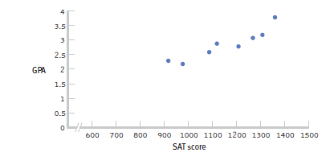
Positive Correlation
High scores on one variable tend to have high scores on the other variable
Adapted from: http://www.sjsu.edu/people/steven.macramalla/courses/stats95/s1/lecture 10

Slide 84
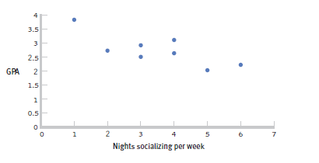
Negative Correlation
High scores on one variable tend to have low scores on the other variable ‘inverse relation’
Adapted from: http://www.sjsu.edu/people/steven.macramalla/courses/stats95/s1/lecture 10

Slide 85
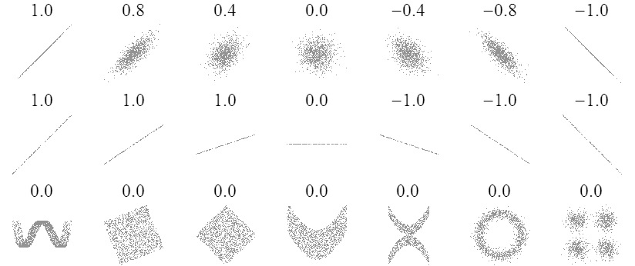
Sample Correlations
Adapted from: http://www.sjsu.edu/people/steven.macramalla/courses/stats95/s1/lecture 10
85

Slide 86
Check your learning
Which is stronger?
A correlation of 0.25 or -0.74?

Slide 87
Correlation Significance
Strength and significance both matter
Notes:
Equivalent to strength for a t-test? Size of difference

Slide 88
Correlation Hypothesis Testing
1 Identify the population, distribution, and assumptions

Slide 89
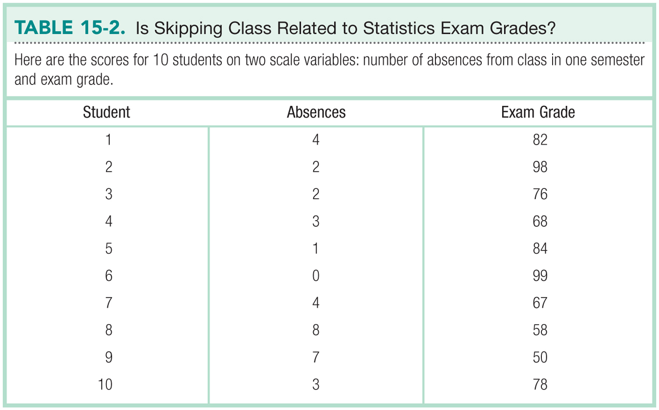
Adapted from: http://www.sjsu.edu/people/steven.macramalla/courses/stats95/s1/lecture 10

Slide 90
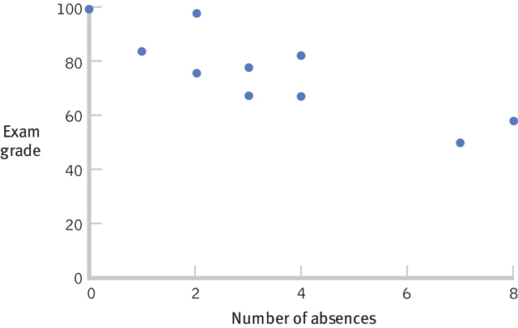
Always Start with a Scatterplot
Adapted from: http://www.sjsu.edu/people/steven.macramalla/courses/stats95/s1/lecture 10

Slide 91
Correlation Hypothesis Testing
1 Identify the population, distribution, and assumptions
2 State the null and research hypotheses

Slide 92
Correlation Hypothesis Testing
1 Identify the population, distribution, and assumptions
2 State the null and research hypotheses
H₀: There is no statistically significant relationship between the variables
H₁: There is a statistically significant relationship between the variables

Slide 93
Correlation Hypothesis Testing
1 Identify the population, distribution, and assumptions
2 State the null and research hypotheses
3 Determine the characteristics of the comparison distribution

Slide 94
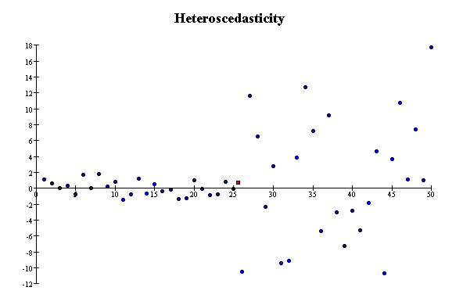
Correlation Assumptions
Key Assumptions:
X values are normally distributed within the population (for each Y)
Y values are normally distributed within the population (for each X)
X and Y have a linear relationship
There are no significant outliers
Scatter doesn’t vary over X or Y

Slide 95
Correlation Hypothesis Testing
1 Identify the population, distribution, and assumptions
2 State the null and research hypotheses
3 Determine the characteristics of the comparison distribution
4 Determine the critical values

Slide 96
Calculating the Pearson Correlation Coefficient
Sample correlation coefficient:
or the algebraic equivalent:
where:
r = Sample correlation coefficient
n = Sample size
x = Value of the independent variable
y = Value of the dependent variable
Adapted from http://www.fordham.edu/economics/Vinod/correl-regr.ppt

Slide 97
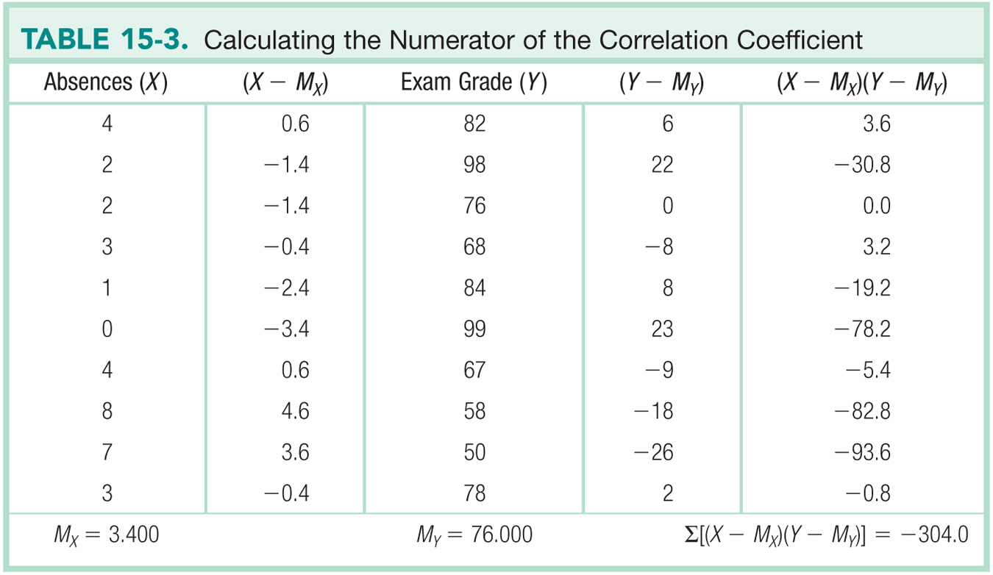
Adapted from: http://www.sjsu.edu/people/steven.macramalla/courses/stats95/s1/lecture 10

Slide 98
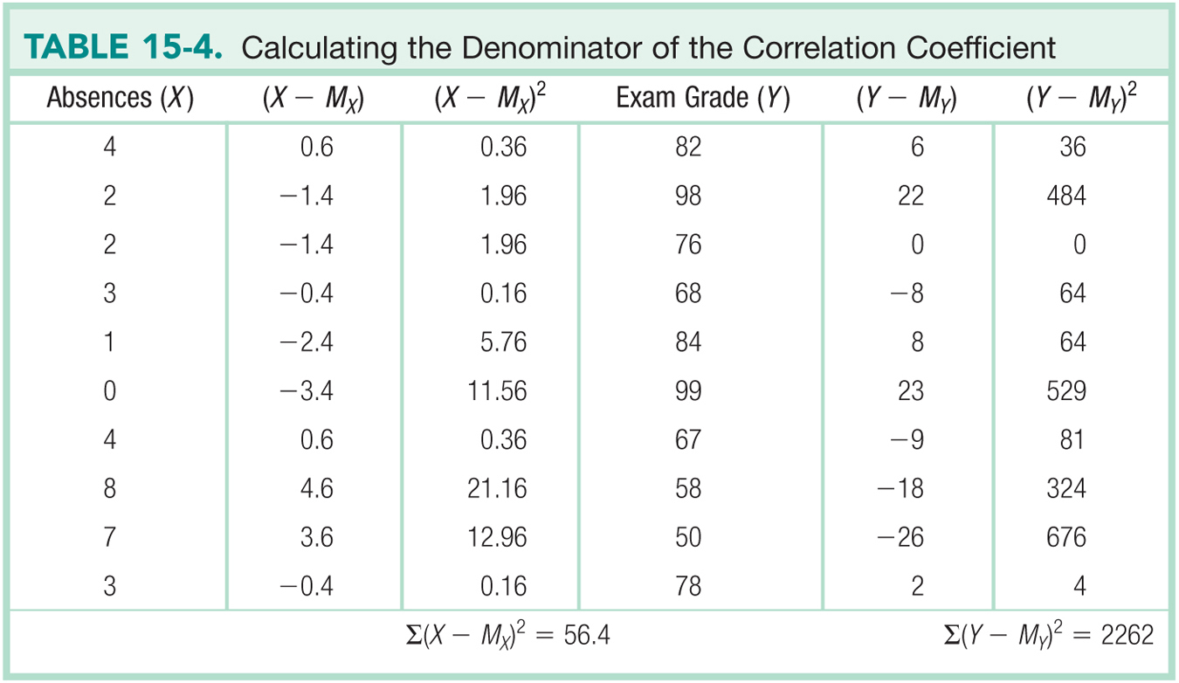
Adapted from: http://www.sjsu.edu/people/steven.macramalla/courses/stats95/s1/lecture 10

Slide 99
Calculating the Pearson Correlation Coefficient
Sample correlation coefficient:

Slide 100
Calculating the Pearson Correlation Coefficient
We know there is as strong, inverse relationship. Is it significant?

Slide 101
Significance Test for Correlation
Adapted from http://www.fordham.edu/economics/Vinod/correl-regr.ppt

Slide 102
Correlation Hypothesis Testing
1 Identify the population, distribution, and assumptions
2 State the null and research hypotheses
3 Determine the characteristics of the comparison distribution
4 Determine the critical values
5 State decision rule |t| < |t| => H₁ is rejected

Slide 103
Significance Test for Correlation
d.f. = 10-2 = 8
α/2=.025
α/2=.025
Reject H₀
-t_{α/2}
Do not reject H₀
t_{α/2}
Reject H₀
0
2.306
-2.306
4.56
Adapted from http://www.fordham.edu/economics/Vinod/correl-regr.ppt

Slide 104
Correlation Hypothesis Testing
1 Identify the population, distribution, and assumptions
2 State the null and research hypotheses
3 Determine the characteristics of the comparison distribution
4 Determine the critical values
5 State decision rule |t| < |t| => H₁ is rejected
6 State conclusion |-4.56| > 2.36 => Reject H₀
Correlation is significant with 95% confidence

Slide 105
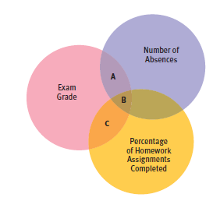
Partial Correlation
Quantifies the degree of association between two variables after statistically removing the association of a third variable with both of those two variables.
e.g., number of absences and exam grade, over and above the correlation of percentage of completed homework assignments with these variables.
Adapted from: http://www.sjsu.edu/people/steven.macramalla/courses/stats95/s1/lecture 10

Slide 106
Example
A study of graduates’ salaries showed negative association between economists’ starting salary and the level of the degree
PhDs earned less than Masters degree holders, who in turn earned less than those with just a Bachelor’s degree
Why?
The data was split into three employment sectors
Teaching, government and private industry
Each sector showed a positive relationship
Employer type was confounded with degree level
Adapted from: http://www.sjsu.edu/people/steven.macramalla/courses/stats95/s1/lecture 10

Slide 107
Continuous outcome (means)
Outcome Variable | Are the observations independent or correlated? |  | Alternatives if the normality assumption is violated (and small sample size):
 | independent | correlated
Continuous (e.g. pain scale, cognitive function) | T-test: compares means between two independent groups ANOVA: compares means between more than two independent groups Pearson’s correlation coefficient (linear correlation): shows linear correlation between two continuous variables Linear regression: multivariate regression technique used when the outcome is continuous; gives slopes | Paired t-test: compares means between two related groups (e.g., the same subjects before and after) Repeated-measures ANOVA: compares changes over time in the means of two or more groups (repeated measurements) Mixed models/GEE modeling: multivariate regression techniques to compare changes over time between two or more groups; gives rate of change over time | Non-parametric statistics Wilcoxon sign-rank test: non-parametric alternative to the paired ttest Wilcoxon sum-rank test (=Mann-Whitney U test): non-parametric alternative to the ttest Kruskal-Wallis test: non-parametric alternative to ANOVA Spearman rank correlation coefficient: non-parametric alternative to Pearson’s correlation coefficient
Adapted from: www.stanford.edu/~kcobb/hrp259/lecture13.ppt

Slide 108
Regression

Slide 109
Goals for Regression
After this, you should be able to:
Calculate and interpret the simple linear regression equation for a set of data
Understand the assumptions behind regression analysis
Determine whether a regression model is significant
Adapted from http://www.fordham.edu/economics/Vinod/correl-regr.ppt

Slide 110
Goals for Regression
(continued)
After this, you should be able to:
Recognize regression analysis applications for purposes of prediction and description
Recognize some potential problems if regression analysis is used incorrectly
Recognize nonlinear relationships between two variables
Adapted from http://www.fordham.edu/economics/Vinod/correl-regr.ppt

Slide 111
Statistical Regression Analysis
Regression analysis is used to:
Predict the value of a dependent variable based on the value of at least one independent variable
Explain the impact of changes in an independent variable on the dependent variable
Dependent variable: the variable we wish to explain
Independent variable: the variable used to do so
Adapted from http://www.fordham.edu/economics/Vinod/correl-regr.ppt

Slide 112
Relationship with correlation
In correlation, the two variables are treated as equals.
In regression, one variable is considered independent (=predictor) variable (X) and the other the dependent (=outcome) variable Y.

Slide 113
Regression in Machine Learning
Regression analysis is used to:
Predict the value of a continues variable based on the value of one or more features
Dependent variable: the outcome we wish to predict
Features: summaries of information about things we measured that should predict the outcome

Slide 114
Simple Linear Regression Model
Only one independent variable, x
Relationship between x and y is described by a linear function
Changes in y are assumed to be caused by changes in x
Adapted from http://www.fordham.edu/economics/Vinod/correl-regr.ppt

Slide 115
Population Linear Regression
The population regression model:
Population Slope Coefficient
Random Error term, or residual
Population y intercept
Independent Variable
Dependent Variable
Linear component
Random Error
component
Adapted from http://www.fordham.edu/economics/Vinod/correl-regr.ppt

Slide 116
Population Linear Regression
y
Observed Value of y for x_{i}
Random Error for x_{i}
ε_{i}
Slope = β₁
Predicted Value of y for x_{i}
Regression Line
Intercept = β₀
x_{i}
x
Adapted from http://www.fordham.edu/economics/Vinod/correl-regr.ppt

Slide 117
Estimated Regression Model
y
Estimated Intercept = b₀
Estimated Regression Line
Estimated Slope = b₁
x
Notes:
Is this any good? How do you know?

Slide 118
Better Estimate
y
Random Error for x_{i}
e_{i}
b₁
b₀
x
x
Notes:
Better?

Slide 119
Estimated Regression Model
y
Observed y for x_{i}
Random Error for x_{i}
e_{i}
b₁
Predicted for x_{i}
b₀
x
x_{i}
x
The individual random error terms e_{i} have a mean of zero
Notes:
We need to solve for y by estimating b0 and b1
b₀ is the estimated average value of y when the value of x is zero
b₁ is the estimated change in the average value of y as a result of a one-unit change in x
The simple regression line always passes through the mean of the y variable and the mean of the x variable

Slide 120
Least Squares Criterion
b₀ and b₁ must minimize
y
e_{i}
Estimated Slope = b₁
Intercept = b₀
x

Slide 121
Least Squares Criterion
b₀ and b₁ must minimize
y
Observed Value of y for x_{i}
e_{i}
Estimated Slope = b₁
Predicted Value for x_{i}
Intercept = b₀
x
Notes:
Note we can replace y-cap with b0 – b1x

Slide 122
Least Squares Criterion
b₀ and b₁ must minimize
Adapted from http://www.fordham.edu/economics/Vinod/correl-regr.ppt
Notes:
Note we can replace y-cap with b0 – b1x

Slide 123
Least Squares Regression Properties
The sum of the residuals from the least squares regression line is 0.
The sum of the squared residuals is a minimum.
The simple regression line always passes through the mean of the y variable and the mean of the x variable.
The least squares coefficients are unbiased estimates of β₀ and β₁.
Adapted from www.clt.astate.edu/asyamil/groebner/ppts/PP11final.ppt

Slide 124
Linear Regression Assumptions
Error values (ε) are statistically independent
Error values are normally distributed for any given value of x
The probability distribution of the errors is normal
The probability distribution of the errors has constant variance
The underlying relationship between the x variable and the y variable is linear
Adapted from www.clt.astate.edu/asyamil/groebner/ppts/PP11final.ppt
Notes:
In machine learning we can play with these a bit – will get to this next week

Slide 125
Simple Linear Regression Example
A real estate agent wishes to examine the relationship between the selling price of a home and its size (measured in square feet)
A random sample of 10 houses is selected
Dependent variable (y) = house price in $1000s
Independent variable (x) = square feet
Adapted from http://www.fordham.edu/economics/Vinod/correl-regr.ppt

Slide 126
Sample Data for House Price Model
House Price in $1000s (y) | Square Feet (x)
245 | 1400
312 | 1600
279 | 1700
308 | 1875
199 | 1100
219 | 1550
405 | 2350
324 | 2450
319 | 1425
255 | 1700
Adapted from http://www.fordham.edu/economics/Vinod/correl-regr.ppt

Slide 127
Graphical Presentation
House price model: scatter plot and regression line
Slope
= 0.10977
Intercept
= 98.248
Adapted from http://www.fordham.edu/economics/Vinod/correl-regr.ppt
Notes:
Here, no houses had 0 square feet, so b₀ = 98.24833 just indicates that, for houses within the range of sizes observed, $98,248.33 is the portion of the house price not explained by square feet

Slide 128
Graphical Presentation
House price model: scatter plot and regression line
Slope
= 0.10977
Intercept
= 98.248
Adapted from http://www.fordham.edu/economics/Vinod/correl-regr.ppt

Slide 129
Graphical Presentation
House price model: scatter plot and regression line
Slope
= 0.10977
Intercept
= 98.248
Adapted from http://www.fordham.edu/economics/Vinod/correl-regr.ppt
Notes:
Here, b₁ = .10977 tells us that the average value of a house increases by .10977($1000) = $109.77, on average, for each additional one square foot of size

Slide 130
Example: House Prices
Estimated Regression Equation:
House Price in $1000s (y) | Square Feet (x)
245 | 1400
312 | 1600
279 | 1700
308 | 1875
199 | 1100
219 | 1550
405 | 2350
324 | 2450
319 | 1425
255 | 1700
Predict the price for a house with 2000 square feet
Adapted from http://www.fordham.edu/economics/Vinod/correl-regr.ppt

Slide 131
Example: House Prices
Estimated Regression Equation:
House Price in $1000s (y) | Square Feet (x)
245 | 1400
312 | 1600
279 | 1700
308 | 1875
199 | 1100
219 | 1550
405 | 2350
324 | 2450
319 | 1425
255 | 1700
Predict the price for a house with 2000 square feet
Adapted from http://www.fordham.edu/economics/Vinod/correl-regr.ppt

Slide 132
Example: House Prices
Estimated Regression Equation:
House Price in $1000s (y) | Square Feet (x)
245 | 1400
312 | 1600
279 | 1700
308 | 1875
199 | 1100
219 | 1550
405 | 2350
324 | 2450
319 | 1425
255 | 1700
Predict the price for a house with 2000 square feet
The predicted price for a house with 2000 square feet is 317.85($1,000s) = $317,850
Adapted from http://www.fordham.edu/economics/Vinod/correl-regr.ppt

Slide 133
Further Analysis: Test for significance
t test for a population slope
Is there a linear relationship between x and y?
Null and alternative hypotheses
H₀: β₁ = 0 (no linear relationship)
H₁: β₁ ≠ 0 (linear relationship does exist)
Test statistic
where:
b₁ = Sample regression slope
coefficient
β₁ = Hypothesized slope
s_{b1} = Estimator of the standard
error of the slope
Notes:
Xx Where does B1 come from? … http://stattrek.com/regression/slope-test.aspx

Slide 134
Explained and Unexplained Variation
(continued)
y
y_{i}
∧
∧
SSE = ∑(y_{i} - y_{i} )²
y
_
SST = ∑(y_{i} - y)²
∧
y
_
∧
_
SSR = ∑(y_{i} - y)²
_
y
y
x
X_{i}

Slide 135
Explained and Unexplained Variation
SSE = Error sum of squares. Variation attributable to factors other than the relationship between x and y
(continued)
y
y_{i}
∧
∧
SSE = ∑(y_{i} - y_{i} )²
y
_
SST = ∑(y_{i} - y)²
∧
y
_
∧
_
SSR = ∑(y_{i} - y)²
_
y
y
x
X_{i}

Slide 136
Unexplained error in House Price Model (SSE)
Unexplained variation makes R² .581
Intercept
= 98.248
Notes:
Here, b₁ = .10977 tells us that the average value of a house increases by .10977($1000) = $109.77, on average, for each additional one square foot of size

Slide 137
Explained and Unexplained Variation
SSE = Error sum of squares. Used to calculate Standard Error of regression
(continued)
y
y_{i}
∧
∧
SSE = ∑(y_{i} - y_{i} )²
y
_
SST = ∑(y_{i} - y)²
∧
y
_
∧
_
SSR = ∑(y_{i} - y)²
_
y
y
x
X_{i}

Slide 138
Standard Error of Estimate
The standard deviation of the variation of observations around the regression line is estimated by
Where
SSE = Sum of squares error
n = Sample size
k = number of independent variables in the model
Adapted from http://www.fordham.edu/economics/Vinod/correl-regr.ppt

Slide 139
Explained and Unexplained Variation
SST = Total sum of squares. Used for R². Measures the variation of the y_{i} values around their mean y
(continued)
y
y_{i}
∧
∧
SSE = ∑(y_{i} - y_{i} )²
y
_
SST = ∑(y_{i} - y)²
∧
y
_
∧
_
SSR = ∑(y_{i} - y)²
_
y
y
SSR = Regression sum of squares. Used for R². Explained variation attributable to the relationship between x and y
x
X_{i}

Slide 140
Simple Linear Regression Analysis
COEFFICIENT OF DETERMINATION (R²)
(sum of squares regression)
(total sum of squares)
Notes:
The coefficient of determination is the portion of the total variation in the dependent variable that is explained by its relationship with the independent variable. The coefficient of determination is also called R-squared and is denoted as R2.

Slide 141
Simple Linear Regression Analysis
COEFFICIENT OF DETERMINATION (R²)
House Price in $1000s (y) | Square Feet (x) | Predicted House Price (ŷ)
245 | 1400 | 251.97
312 | 1600 | 273.93
279 | 1700 | 284.91
308 | 1875 | 304.125
199 | 1100 | 219.03
219 | 1550 | 268.44
405 | 2350 | 356.28
324 | 2450 | 367.26
319 | 1425 | 254.715
255 | 1700 | 284.91
Notes:
The coefficient of determination is the portion of the total variation in the dependent variable that is explained by its relationship with the independent variable. The coefficient of determination is also called R-squared and is denoted as R2.

Slide 142
Simple Linear Regression Analysis
COEFFICIENT OF DETERMINATION (R²)
House Price in $1000s (y) | Square Feet (x) | Predicted House Price (ŷ)
245 | 1400 | 251.97
312 | 1600 | 273.93
279 | 1700 | 284.91
308 | 1875 | 304.125
199 | 1100 | 219.03
219 | 1550 | 268.44
405 | 2350 | 356.28
324 | 2450 | 367.26
319 | 1425 | 254.715
255 | 1700 | 284.91
Predicted y
Notes:
The coefficient of determination is the portion of the total variation in the dependent variable that is explained by its relationship with the independent variable. The coefficient of determination is also called R-squared and is denoted as R2.

Slide 143
Simple Linear Regression Analysis
COEFFICIENT OF DETERMINATION (R²)
House Price in $1000s (y) | Square Feet (x) | Predicted House Price (ŷ)
245 | 1400 | 251.97
312 | 1600 | 273.93
279 | 1700 | 284.91
308 | 1875 | 304.125
199 | 1100 | 219.03
219 | 1550 | 268.44
405 | 2350 | 356.28
324 | 2450 | 367.26
319 | 1425 | 254.715
255 | 1700 | 284.91
Mean y
Notes:
The coefficient of determination is the portion of the total variation in the dependent variable that is explained by its relationship with the independent variable. The coefficient of determination is also called R-squared and is denoted as R2.

Slide 144
Simple Linear Regression Analysis
COEFFICIENT OF DETERMINATION (R²)
House Price in $1000s (y) | Square Feet (x) | Predicted House Price (ŷ)
245 | 1400 | 251.97
312 | 1600 | 273.93
279 | 1700 | 284.91
308 | 1875 | 304.125
199 | 1100 | 219.03
219 | 1550 | 268.44
405 | 2350 | 356.28
324 | 2450 | 367.26
319 | 1425 | 254.715
255 | 1700 | 284.91
Mean y = 286.5
Notes:
The coefficient of determination is the portion of the total variation in the dependent variable that is explained by its relationship with the independent variable. The coefficient of determination is also called R-squared and is denoted as R2.

Slide 145
Simple Linear Regression Analysis
COEFFICIENT OF DETERMINATION (R²)
House Price in $1000s (y) | Square Feet (x) | Predicted House Price (ŷ)
245 | 1400 | 251.97
312 | 1600 | 273.93
279 | 1700 | 284.91
308 | 1875 | 304.125
199 | 1100 | 219.03
219 | 1550 | 268.44
405 | 2350 | 356.28
324 | 2450 | 367.26
319 | 1425 | 254.715
255 | 1700 | 284.91
Notes:
The coefficient of determination is the portion of the total variation in the dependent variable that is explained by its relationship with the independent variable. The coefficient of determination is also called R-squared and is denoted as R2.

Slide 146
Simple Linear Regression Analysis
COEFFICIENT OF DETERMINATION (R²)
House Price in $1000s (y) | Square Feet (x) | Predicted House Price (ŷ)
245 | 1400 | 251.97
312 | 1600 | 273.93
279 | 1700 | 284.91
308 | 1875 | 304.125
199 | 1100 | 219.03
219 | 1550 | 268.44
405 | 2350 | 356.28
324 | 2450 | 367.26
319 | 1425 | 254.715
255 | 1700 | 284.91
Notes:
The coefficient of determination is the portion of the total variation in the dependent variable that is explained by its relationship with the independent variable. The coefficient of determination is also called R-squared and is denoted as R2.

Slide 147
Correlation vs Regression
Pearson correlation coefficient:
Coefficient of determination (Regression):
after minimizing

Slide 148
Multiple Linear Regression
More than one predictor…
E(y)= α + β₁*X + β₂ *W + β₃ *Z…
Each regression coefficient is the amount of change in the outcome variable that would be expected per one-unit change of the predictor, if all other variables in the model were held constant.

Slide 149
Multivariate regression pitfalls
Multi-co-linearity
Two x’s that measure the same thing
Tend to ‘cancel out’ and wreck the model

Slide 150
Multivariate regression pitfalls
Multi-co-linearity
Two x’s that measure the same thing
Tend to ‘cancel out’ and wreck the model
Residual confounding
Hard to estimate

Slide 151
Multivariate regression pitfalls
Multi-co-linearity
Two x’s that measure the same thing
Tend to ‘cancel out’ and wreck the model
Residual confounding
Hard to estimate
Overfitting
Too many x’s for the data
Minimum 10 new samples per new x
Makes the model less predictive on new samples

Slide 152
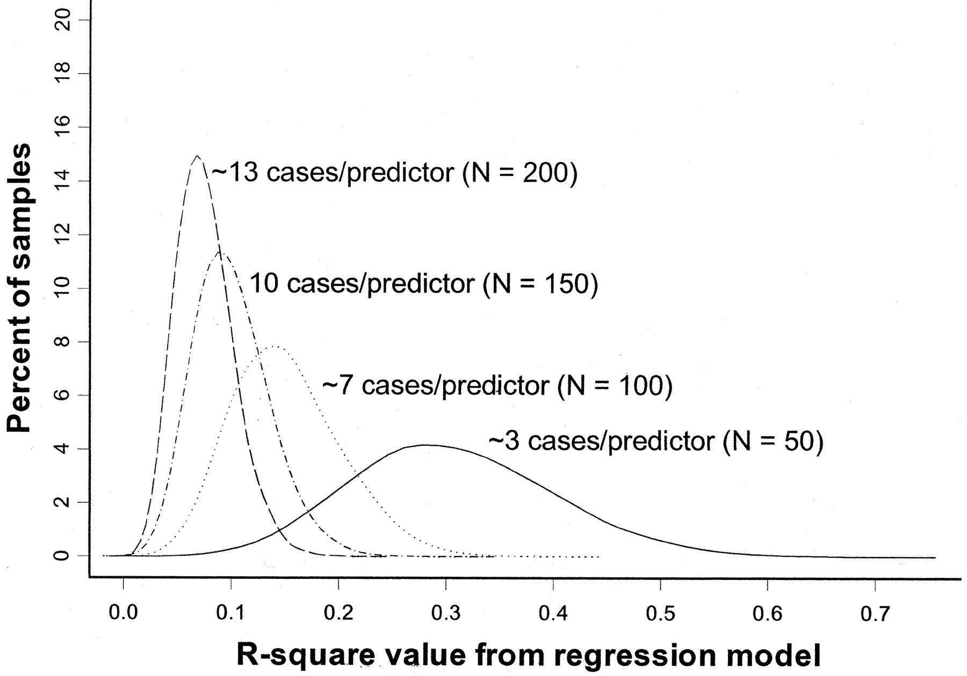
Overfitting simulation (where we know the ‘true’ population has R²=0)
All regression models in simulation have 15 predictors
True R² = 0
(Figure from: Babyak, MA. What You See May Not Be What You Get: A Brief, Nontechnical Introduction to Overfitting in Regression-Type Models. Psychosomatic Medicine 66:411-421 (2004).)
Notes:
The model contained 15 predictors, each consisting of randomly generated values, and a response variable, whose values were also randomly generated

Slide 153
Overfitting: 3 cases/predictor: mean R² looks like .3
R² distribution for 10,000 regressions based on 10,000 random samples of the data (N=50).
(Figure from: Babyak, MA. What You See May Not Be What You Get: A Brief, Nontechnical Introduction to Overfitting in Regression-Type Models. Psychosomatic Medicine 66:411-421 (2004).)
Notes:
Y axis is percent of sample distributions that had a given R2 value (for that N). X axis is distribution of R2 values across the 10,000 regressions (for that N)

Slide 154
Overfitting: 13 cases/predictor: mean R² looks like .05
R² distribution for 10,000 regressions based on 10,000 random samples of the data (N=200)
(Figure from: Babyak, MA. What You See May Not Be What You Get: A Brief, Nontechnical Introduction to Overfitting in Regression-Type Models. Psychosomatic Medicine 66:411-421 (2004).)

Slide 155
Summary
Introduced correlation analysis
Discussed correlation to measure the strength of a linear association
Introduced simple linear regression analysis
Calculated the coefficients for the simple linear regression equation
Addressed assumptions of regression and correlation
Addressed prediction of individual values
Discussed residual analysis
Adapted from http://www.fordham.edu/economics/Vinod/correl-regr.ppt

Slide 156
Key Review Concepts from Correlation & Regression
We calculate three things for correlation: The slope & intercept of the line; The amount of error (r); and the significance
Outliers & Non-normal & uneven variance values can make this fail
Correlation does not imply causation. Randomized controlled trials are the gold stander for evaluating causation (‘frequency proof’) but logical proofs are also important.

Slide 157
Review, continued
Regression tells us to what extent a group of independent variables predict or explain a dependent variable
It is based on the same assumptions as correlation
In addition, predictor variables that are not independent can mess it up
Over fitting can be a problem (too little data for the number of independent variables)

Slide 158
Continuous outcome (means)
Outcome Variable | Are the observations independent or correlated? |  | Alternatives if the normality assumption is violated (and small sample size):
 | independent | correlated
Continuous (e.g. pain scale, cognitive function) | T-test: compares means between two independent groups ANOVA: compares means between more than two independent groups Pearson’s correlation coefficient (linear correlation): shows linear correlation between two continuous variables Linear regression: multivariate regression technique used when the outcome is continuous; gives slopes | Paired t-test: compares means between two related groups (e.g., the same subjects before and after) Repeated-measures ANOVA: compares changes over time in the means of two or more groups (repeated measurements) Mixed models/GEE modeling: multivariate regression techniques to compare changes over time between two or more groups; gives rate of change over time | Non-parametric statistics Wilcoxon sign-rank test: non-parametric alternative to the paired ttest Wilcoxon sum-rank test (=Mann-Whitney U test): non-parametric alternative to the ttest Kruskal-Wallis test: non-parametric alternative to ANOVA Spearman rank correlation coefficient: non-parametric alternative to Pearson’s correlation coefficient
Adapted from: www.stanford.edu/~kcobb/hrp259/lecture13.ppt

Slide 159
Binary or categorical outcomes (proportions)
Outcome Variable | Are the observations correlated? |  | Alternative to the chi-square test if sparse cells:
 | independent | correlated
Binary or categorical (e.g. fracture, yes/no) | Chi-square test: compares proportions between two or more groups Relative risks: odds ratios or risk ratios Logistic regression: multivariate technique used when outcome is binary; gives multivariate-adjusted odds ratios | McNemar’s chi-square test: compares binary outcome between correlated groups (e.g., before and after) Conditional logistic regression: multivariate regression technique for a binary outcome when groups are correlated (e.g., matched data) GEE modeling: multivariate regression technique for a binary outcome when groups are correlated (e.g., repeated measures) | Fisher’s exact test: compares proportions between independent groups when there are sparse data (some cells <5). McNemar’s exact test: compares proportions between correlated groups when there are sparse data (some cells <5).
Adapted from: www.stanford.edu/~kcobb/hrp259/lecture13.ppt

